Slide 1
MSc Artificial Intelligence
Knowledge Engineering
Week 4, 12 October 2026
Notes:
This colour bar is to be used for Artificial Intelligence

Slide 2
What can Knowledge Graphs do?
Explicitly model relations between things
Model relations between classes of things
Model hierarchies of things
Be used to identify patterns
Be used directly to derive new knowledge by running logical inference on top of a knowledge graph

Slide 3
Why Graphs?
Graphs are a natural way of representing relationships
  “Things” = vertices on the graph
  “Relationships” = edges on the graph
Rich mathematical structure entail many powerful algorithms
Totally flexible abstract data structure and can be structured to model
Useful to have in mind some basic properties of graphs

Slide 4
Graph Basics
A graph consists of a set V of nodes or vertices and a set E of edges
Each edge is a tuple of two vertices
Vertices v₁ and v₂ are adjacent (ie, connected) if (v₁, v₂) is in E
Edges can be directed
Can represent in terms of matrices

Slide 5
How to structure graphs
Graphs provide a powerful mathematical foundation
But we need to structure them to model a specific problem
Specifically, we need to decide what features of a problem a graph should represent
And what relationships it should include.
This can be specified by an ontology

Slide 6
Ontologies
An Ontology is a formal way of specifiying the “things” in a domain, their properties, and the relationships between them.
It is a schema for modelling the problem
Derived from domain knowledge
Knowledge graphs are structured according to an ontology
Specific facts/data are then instantiated

Slide 7
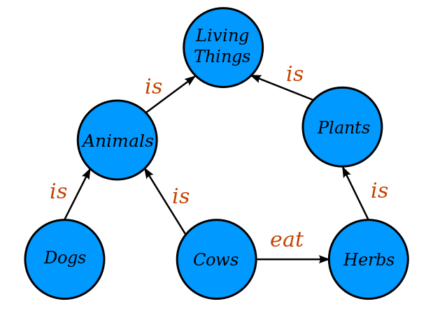
Steps in creating an ontology
Define the entities – the fundamental concepts in the domain?
What are the relationships between the entities?
What properties do the entities have?
https://commons.wikimedia.org/wiki/File:Conceptual_Diagram_-_Example.svg licensed under the Creative Commons Attribution-Share Alike 4.0 International license.

Slide 8
Entities
What are the fundamental concepts?
Living things?
Animals?
Plants?
Dogs?
Cows?
Herbs?
It depends…
is
is
https://commons.wikimedia.org/wiki/File:Conceptual_Diagram_-_Example.svg licensed under the Creative Commons Attribution-Share Alike 4.0 International license.
Great Dane
Chihuahua

Slide 9
Relationships
What are the fundamental relations between entities?
Is? (belongs to)
Eats?
Is toxic to?
Are relationships meaningfully bidirectional?
It depends…
is
is
https://commons.wikimedia.org/wiki/File:Conceptual_Diagram_-_Example.svg licensed under the Creative Commons Attribution-Share Alike 4.0 International license.
Great Dane
Chihuahua

Slide 10
Properties
What are the fundamental properties of the entities?
Latin name?
Typical size?
Where it is found?
It depends…
is
is
https://commons.wikimedia.org/wiki/File:Conceptual_Diagram_-_Example.svg licensed under the Creative Commons Attribution-Share Alike 4.0 International license.
Great Dane
Chihuahua

Slide 11
Ontology Guidelines
Does not need to represent everything we know
Not all relationships will matter
Not all properties will be important
Is the colour of a tablet relevant?
  No, if you are a doctor or a patient
  Yes, if you are responsible for manufacturing it

Slide 12
Exercises 9: Designing an Ontology

Slide 13
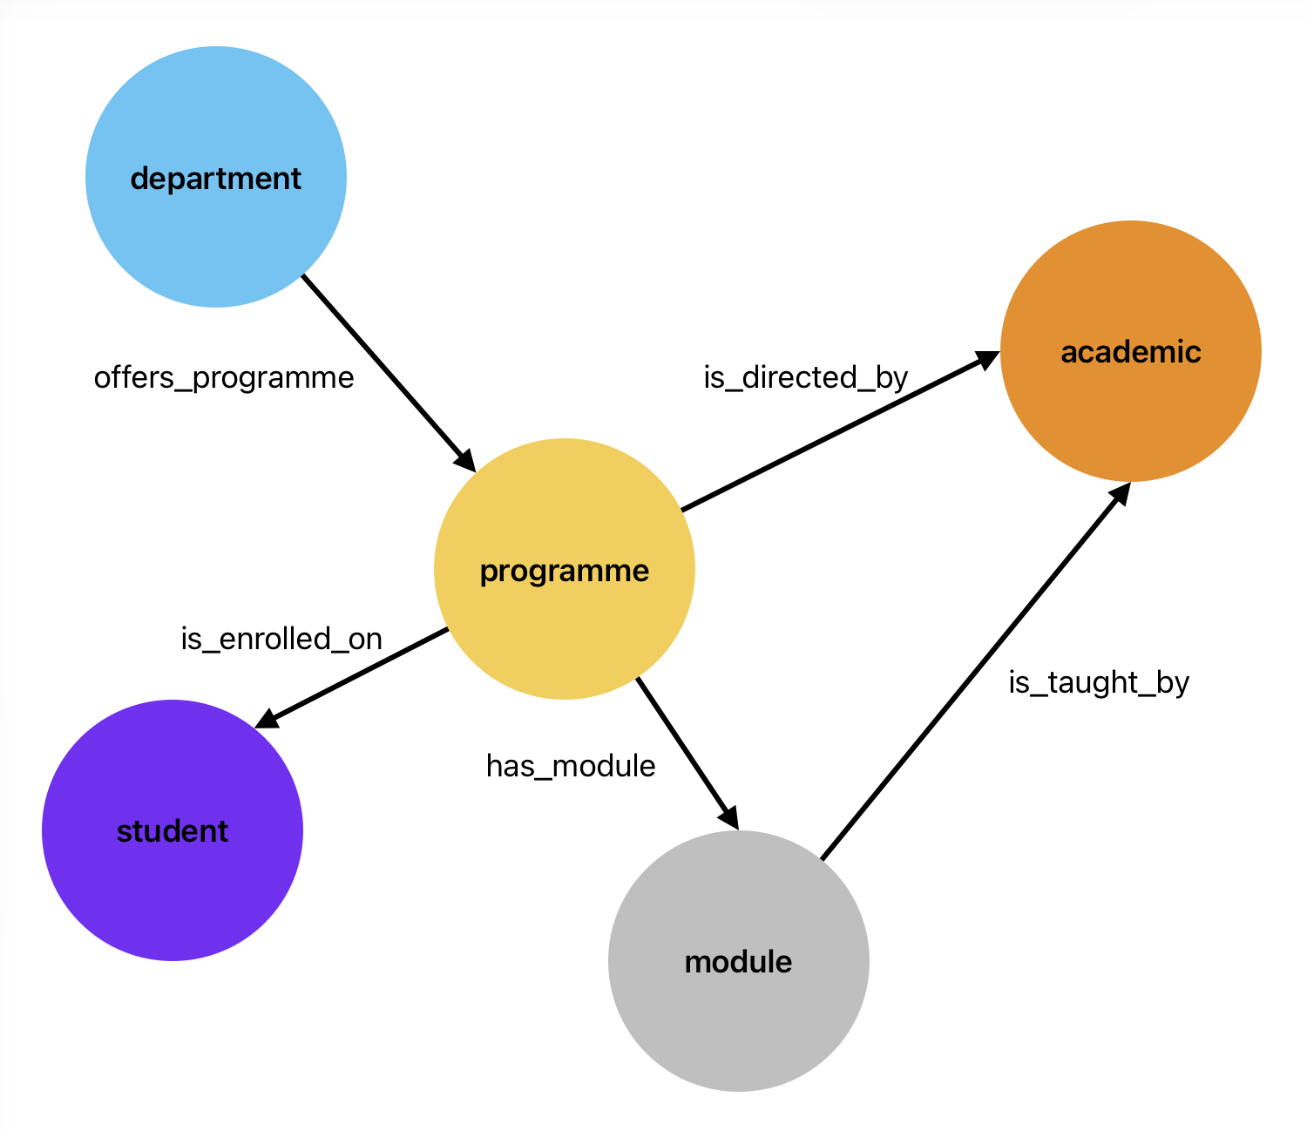
Ontologies
https://commons.wikimedia.org/wiki/File:Conceptual_Diagram_-_Example.svg licensed under the Creative Commons Attribution-Share Alike 4.0 International license.

Slide 14
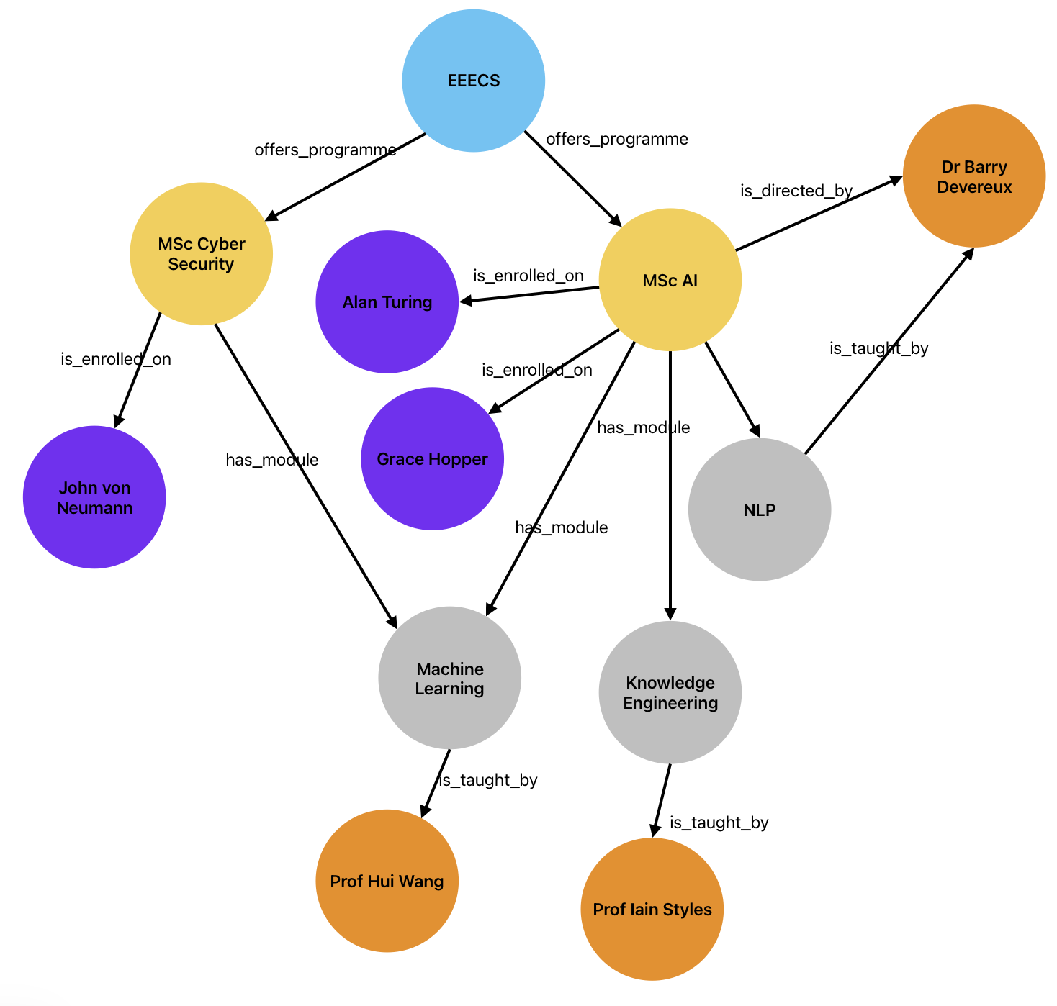
Ontologies are not Knowledge Graphs

Slide 15
Tools for Working with Graphs
Kanren – provides mechanisms for creating and querying graphs
What is missing?
Ontologies – so no error checking
Attributes – nodes only have names
“Familiar” tools for querying
Reasonable import/export mechanisms
Scalability

Slide 16
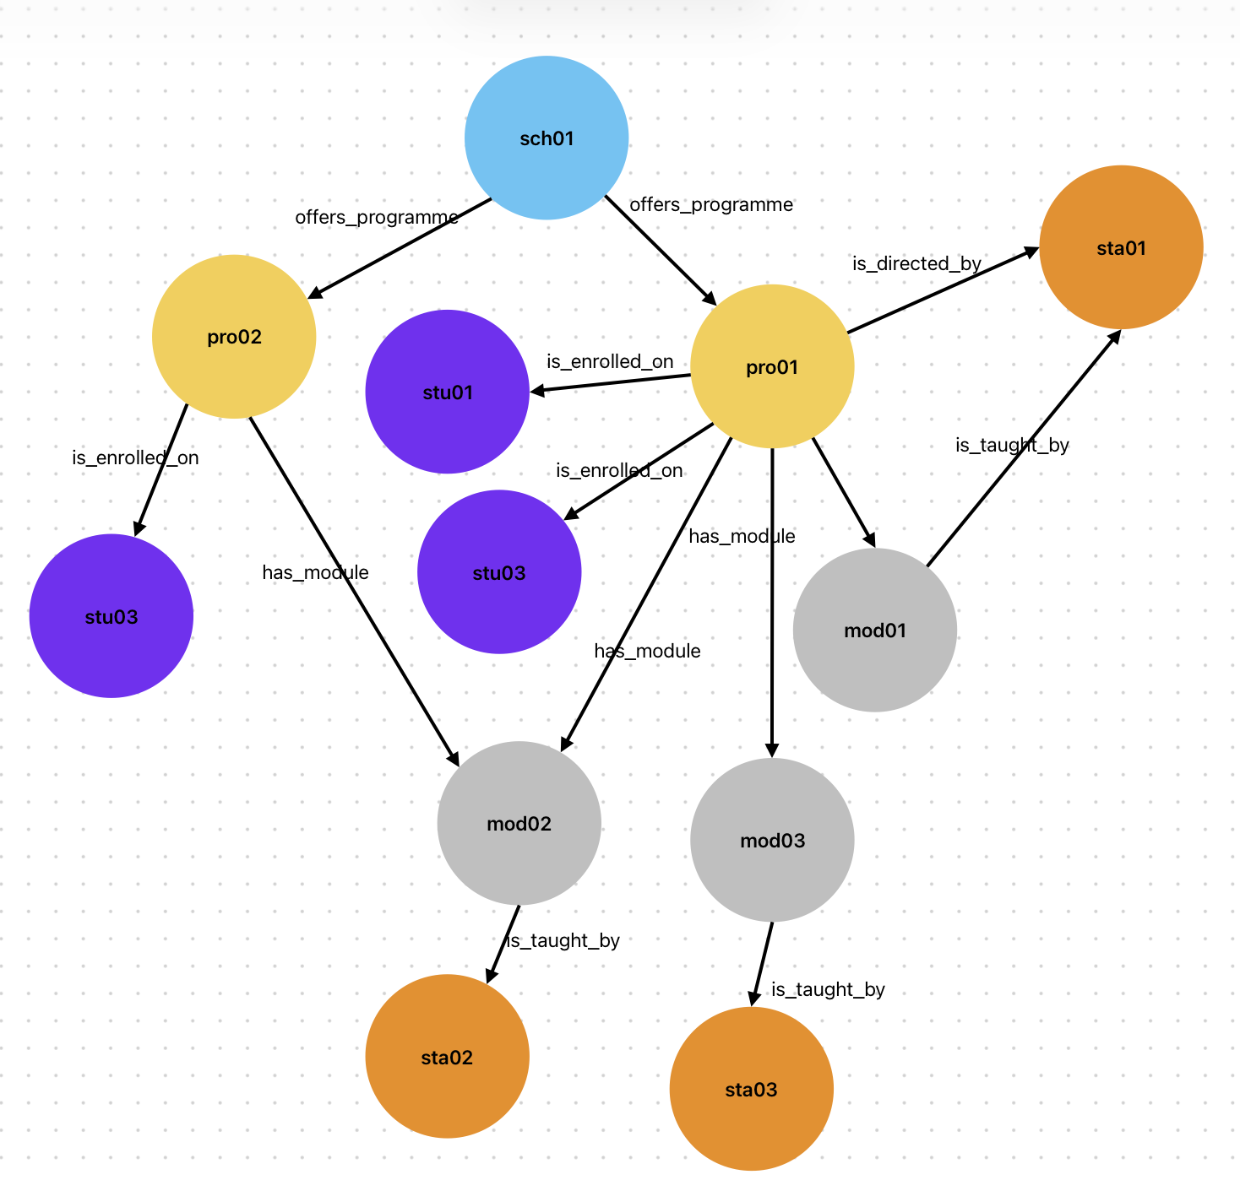
Why do we need attributes?
When would you use an attribute instead of a node?
module_title = “knowledge Engineering
module_id = “ECS8052”
name=“Iain Styles
staff_id = “123456”

Slide 17
So what do we want to do?
Specify an ontology
Instantiate it with facts
Add attributes to nodes
Query the graph using “familiar” notation
Save the graph/ontology in a well-defined and easily importable/exportable format
Perform elementary reasoning on the graph
We will use a package called owlready2 for this

Slide 18
Graph/Ontology Formats
Ontology representations designed to be “human readable” and machine parseable.
In practice, nearly always read/written by tools and read by humans only when strictly necessary.
Several common formats

Slide 19
Examples of different ontology formats
(is_a, dog, mammal)
(is_a, cat, mammal)
(chases, dog, cat)
Simple Triples format
Easy to parse
Portable
Lacks metadata
Extensible

Slide 20
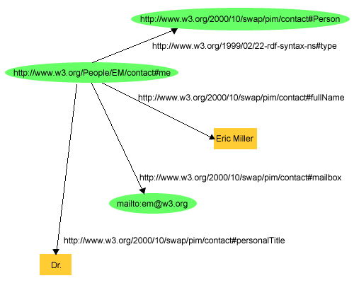
Examples of different ontology formats
<http://www.w3.org/People/EM/contact#me> <http://www.w3.org/1999/02/22-rdf-syntax-ns#type> <http://www.w3.org/2000/10/swap/pim/contact#Person> .
<http://www.w3.org/People/EM/contact#me> <http://www.w3.org/2000/10/swap/pim/contact#fullName> "Eric Miller" .
<http://www.w3.org/People/EM/contact#me> <http://www.w3.org/2000/10/swap/pim/contact#mailbox> <mailto:em@w3.org> .
<http://www.w3.org/People/EM/contact#me> <http://www.w3.org/2000/10/swap/pim/contact#personalTitle> "Dr." .
W3C N-Triples format
Subject– Predicate – Object
Designed for web data
Referenced against external W3C definitions
http://www.w3.org/TR/rdf-primer/fig1dec16.png

Slide 21
Turtle: Terse RDF Triple Language
prefix ns0: <http://www.w3.org/2000/10/swap/pim/contact#> .
http://www.w3.org/People/EM/contact#me a <http://www.w3.org/2000/10/swap/pim/contact#Person> ;
ns0:fullName "Eric Miller" ;
ns0:mailbox <mailto:em@w3.org> ;
ns0:personalTitle "Dr." .
Less repetitive and verbose than N-Triples
Namespaces and nesting

Slide 22
RDF/XML
<?xml version="1.0"?>
<rdf:RDF xmlns:rdf="http://www.w3.org/1999/02/22-rdf-syntax-ns#"
xmlns:contact="http://www.w3.org/2000/10/swap/pim/contact#">
<contact:Person rdf:about="http://www.w3.org/People/EM/contact#me">
<contact:fullName>Eric Miller</contact:fullName>
<contact:mailbox rdf:resource="mailto:em@w3.org"/>
<contact:personalTitle>Dr.</contact:personalTitle>
</contact:Person>
</rdf:RDF>
Very similar but a little more verbose than Turtle
XML-based so can use generic parsers

Slide 23
OWL: Web Ontology Language
<?xml version="1.0"?>
<rdf:RDF xmlns:rdf="http://www.w3.org/1999/02/22-rdf-syntax-ns#"
xmlns:xsd="http://www.w3.org/2001/XMLSchema#"
xmlns:rdfs="http://www.w3.org/2000/01/rdf-schema#"
xmlns:owl="http://www.w3.org/2002/07/owl#"
xml:base="http://www.dummy.info/new.owl"
xmlns="http://www.dummy.info/new.owl#">
<owl:Ontology rdf:about="http://www.dummy.info/new.owl"/>
<owl:Class rdf:about="#Animal">
<rdfs:subClassOf rdf:resource="http://www.w3.org/2002/07/owl#Thing"/>
</owl:Class>
<owl:Class rdf:about="#Dog">
<rdfs:subClassOf rdf:resource="http://www.w3.org/2002/07/owl#Thing"/>
</owl:Class>
<owl:Class rdf:about="#Cat">
<rdfs:subClassOf rdf:resource="http://www.w3.org/2002/07/owl#Thing"/>
</owl:Class>
<owl:ObjectProperty rdf:about="#is_a">
<rdfs:domain rdf:resource="#Dog"/>
<rdfs:range rdf:resource="#Animal"/>
</owl:ObjectProperty>
<owl:ObjectProperty rdf:about="#is_a">
<rdfs:domain rdf:resource="#Cat"/>
<rdfs:range rdf:resource="#Animal"/>
</owl:ObjectProperty>
<owl:ObjectProperty rdf:about="#chases">
<rdfs:domain rdf:resource="#Dog"/>
<rdfs:range rdf:resource="#Cat"/>
</owl:ObjectProperty>
</rdf:RDF>
Like many XML formats, can be very verbose.
XML tooling.
Referenced against external definitions.

Slide 24
Documentation
I found all of the following helpful
https://owlready2.readthedocs.io/en/v0.42/
https://kgtutorial.github.io/
https://jingdongsun.medium.com/creating-knowledge-graph-step-by-step-a383231acf2d
https://iccl.inf.tu-dresden.de/web/Knowledge_Graphs_(WS2021)/en

